Slide 1
Biodiversity in US National Parks
An Assessment by Jacob Maze

Slide 2

Selling your idea
The data for this project was provided by Codecademy, which used data from the US National Parks Service on endangered species in different parks. It is composed of both an observations dataset and a species dataset.

Slide 3



1. Importance of Parks
US national parks provide a vital part of preserving precious ecosystems in North America while also dedicating resources to the conservation of endangered and protected species.
Unexpected “What a country chooses to save is what a country chooses to say about itself.” – Mollie Beattie
Emotional The national parks are home to more than 600 different species of animals.
Simple National parks in the US cover roughly 3.4% of US territories.

Slide 4
A Glimpse of the Observations Dataset
scientific_name | park_name | observations
0 | Vicia benghalensis | Great Smoky Mountains National Park | 68
1 | Neovison vison | Great Smoky Mountains National Park | 77
2 | Prunus subcordata | Yosemite National Park | 138
3 | Abutilon theophrasti | Bryce National Park | 84
4 | Githopsis specularioides | Great Smoky Mountains National Park | 85
Tip
The data collected under this dataset concerns (a) the species’ scientific name (b) the park name, (c) the number of observations.

Slide 5
A Glimpse of the Species Dataset
category | scientific_name | common_names | conservation_status
0 | Mammal | Clethrionomys gapperi gapperi | Gapper's Red-Backed Vole | NaN
1 | Mammal | Bos bison | American Bison, Bison | NaN
2 | Mammal | Bos taurus | Aurochs, Aurochs, Domestic Cattle (Feral), Dom... | NaN
3 | Mammal | Ovis aries | Domestic Sheep, Mouflon, Red Sheep, Sheep (Feral) | NaN
4 | Mammal | Cervus elaphus | Wapiti Or Elk | NaN
Tip
The data collected under this dataset concerns (a) the category of animal (b) the species’ scientific name, (c) the species’ common name, and (d) the species’ conservation status (if any).

Slide 6
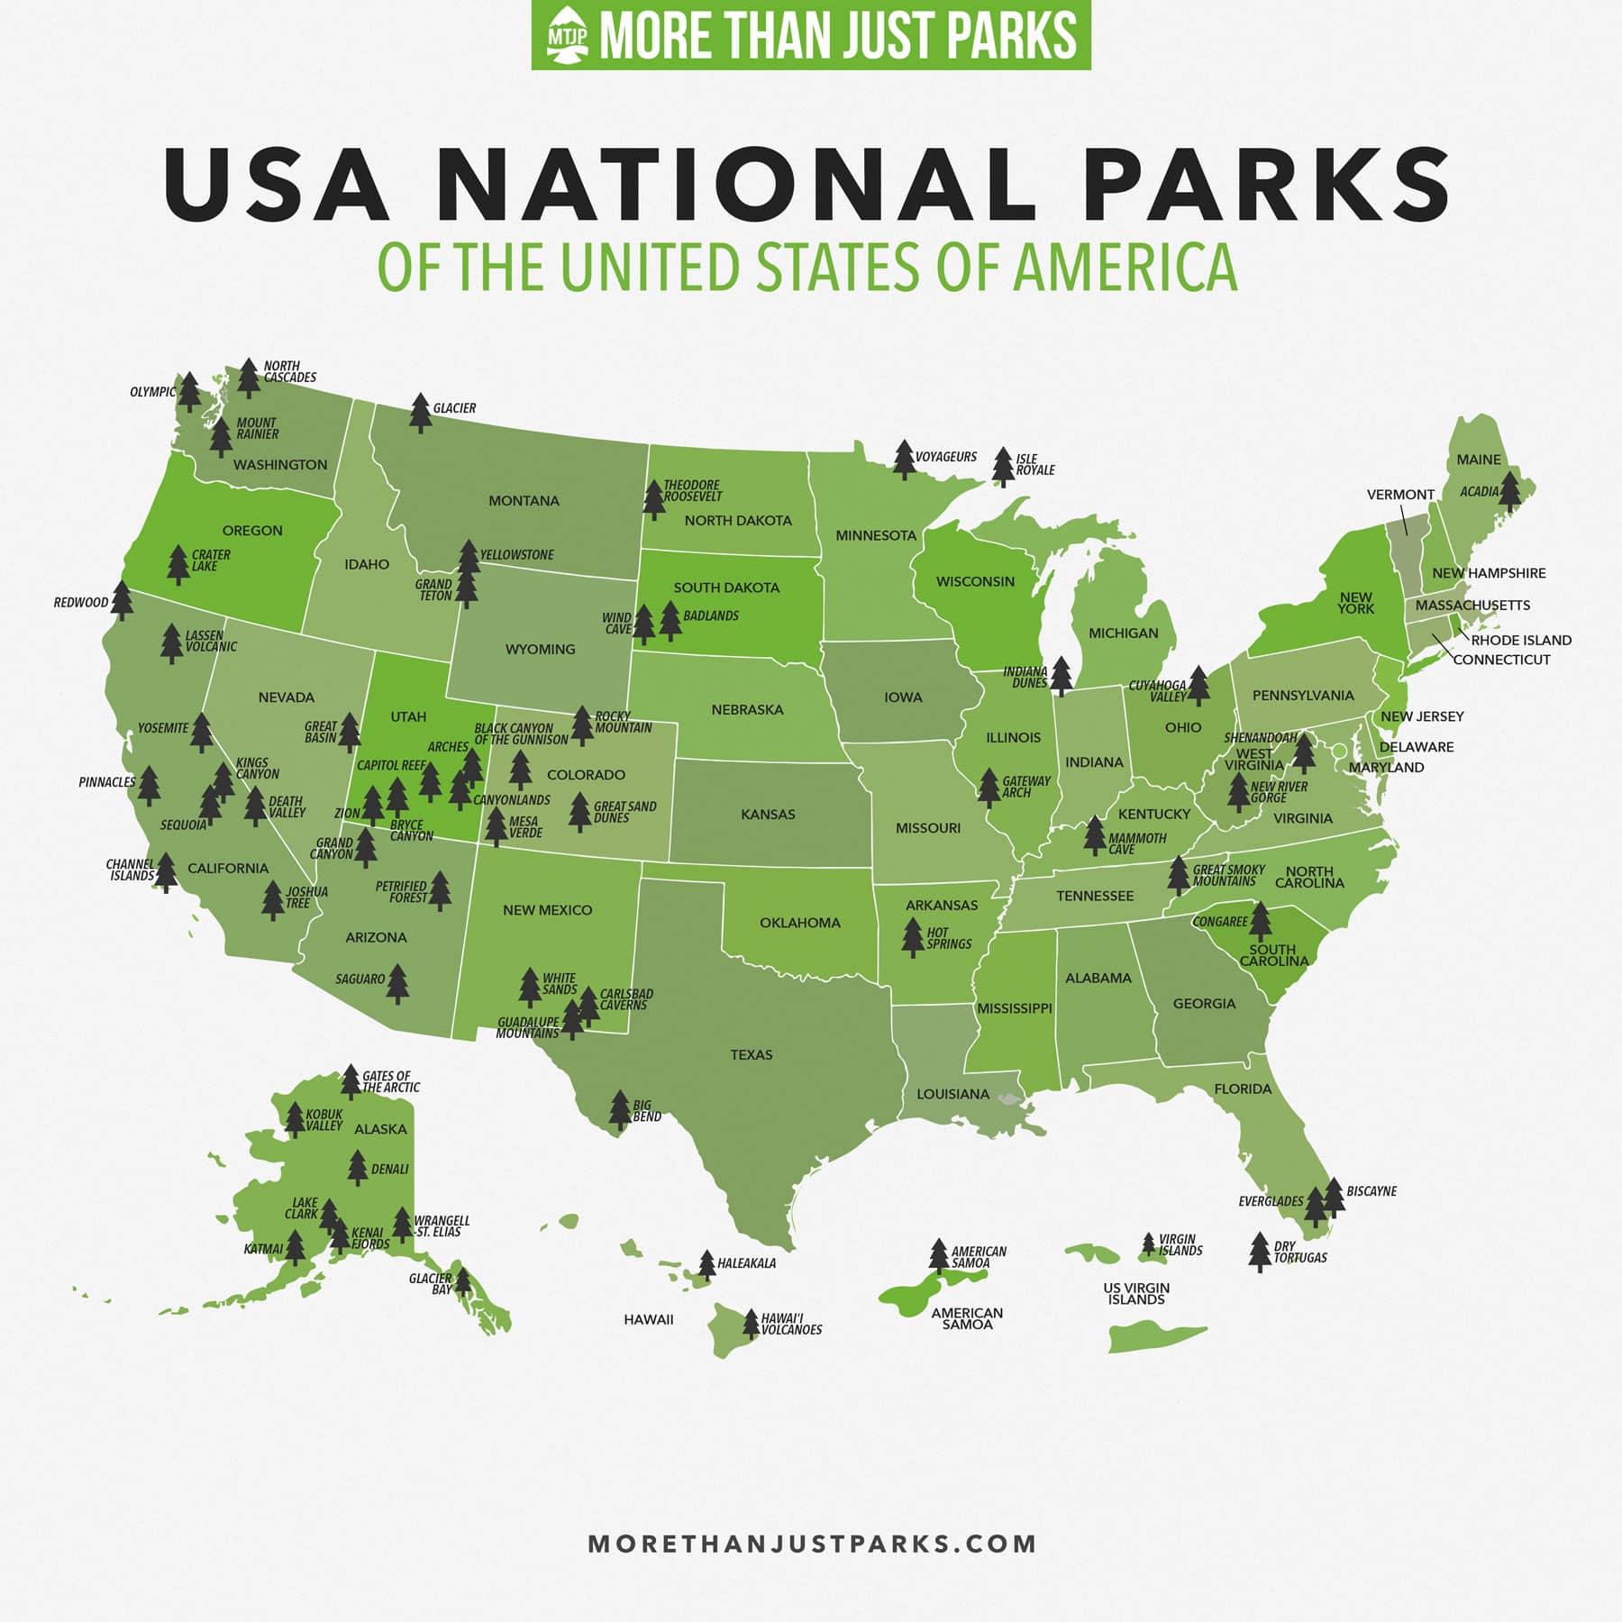
Dataset Parameters
Observations Dataset:
There are 4 parks in the dataset: (a) the Great Smoky Mountains National Parks, (b) Yosemite National Park, (c) Bryce National Park and (d) Yellowstone National Park
The total number of observations over a seven day period was 3,314,739.
Species Dataset:
The number of unique species observed over a seven day period were 5,541.
The number of animal groups observed over a seven day period was seven: (a) mammal, (b) bird, (c) reptile, (d) amphibian, (e) fish, (f) vascular plant, (g) nonvascular plant.
The number of conservation statuses listed was four: (a) species of concern (161), (b) endangered (4), (c) threatened (10) and (d) in recovery (4).

Slide 7
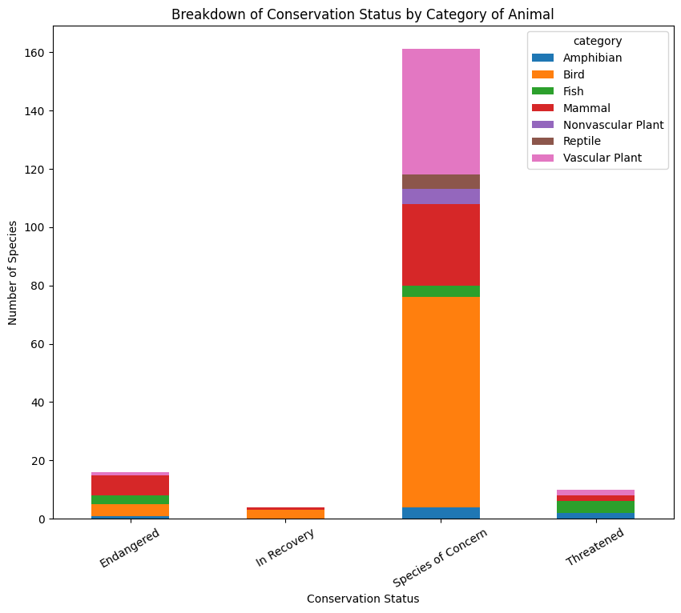

Slide 8

category | not_protected | protected | percent_protected
0 | Amphibian | 72 | 7 | 8.860759
1 | Bird | 413 | 75 | 15.368852
2 | Fish | 115 | 11 | 8.730159
3 | Mammal | 146 | 30 | 17.045455
4 | Nonvascular Plant | 328 | 5 | 1.501502
5 | Reptile | 73 | 5 | 6.410256
6 | Vascular Plant | 4216 | 46 | 1.079305
Tip
Breakdown of Conservation Statuses

Slide 9
Statistical Significance (p-value)
Pairings
Mammals v. Birds | 0.688
Reptiles v. Mammals | 0.038
Mammals v. Vascular Plants | 1.441
Vasuclar Plants v. Birds | 4.612
Fish v. Reptiles | 0.741
Fish v. Mammals | 0.056
Tip
Statistical Significance Difference between Species and Conservation Status

Slide 10
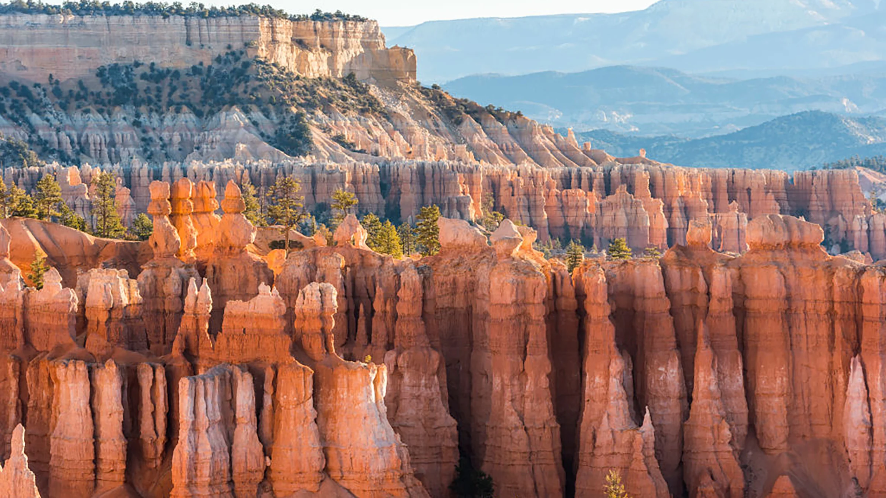
Most species were, by and large, not part of a conservation status. The number of non-conservation status species was 5,633.
Meanwhile, the number of conserved species was 191.
Tip
What is the Distribution of Conservation Status for Species?

Slide 11

Amphibians | 8.86%
Birds | 15.37%
Fish | 8.73%
Mammals | 17.05%
Nonvascular Plants | 1.50%
Reptiles | 6.41%
Vascular Plants | 1.08%
Tip
Are certain types of species more likely to be endangered?

Slide 12

Are the differences between species and their conservation status significant?
The only significance that was illustrated occurred in the case of mammals and reptiles, which was shown to have a significant difference.
All other species did not meet the required threshold.
However, fish and mammals as well as birds and fish were quite close to the designated p-value of 0.05.

Slide 13
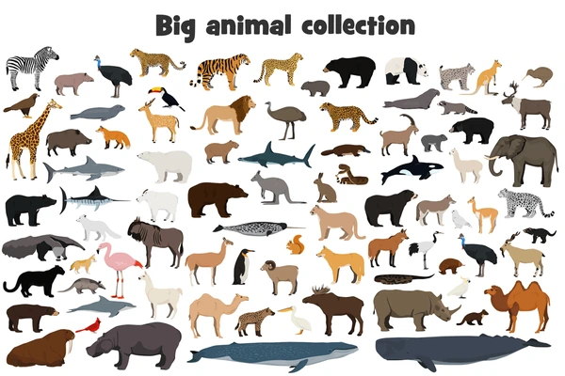
2. Which animal is most prevalent and what is their distribution among parks?
Mammals | Bats
Amphibians | Salamanders
Birds | Warblers
Fish | Shiners
Nonvascular Plants | Moss
Reptiles | Snakes
Vascular Plants | Sedges

Slide 14

Questions?
Tip
Thank you for listening.

Slide 15

Appendix:
Comparative List of Protected and Unprotected Species

Slide 16
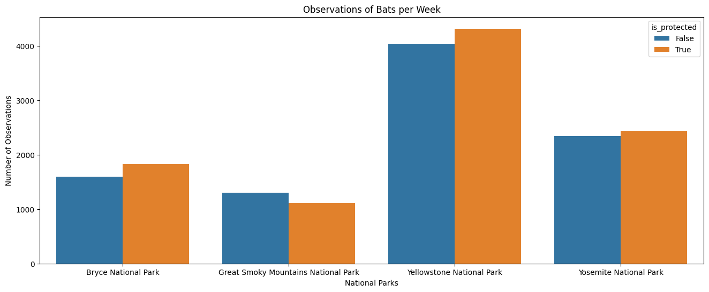

Slide 17
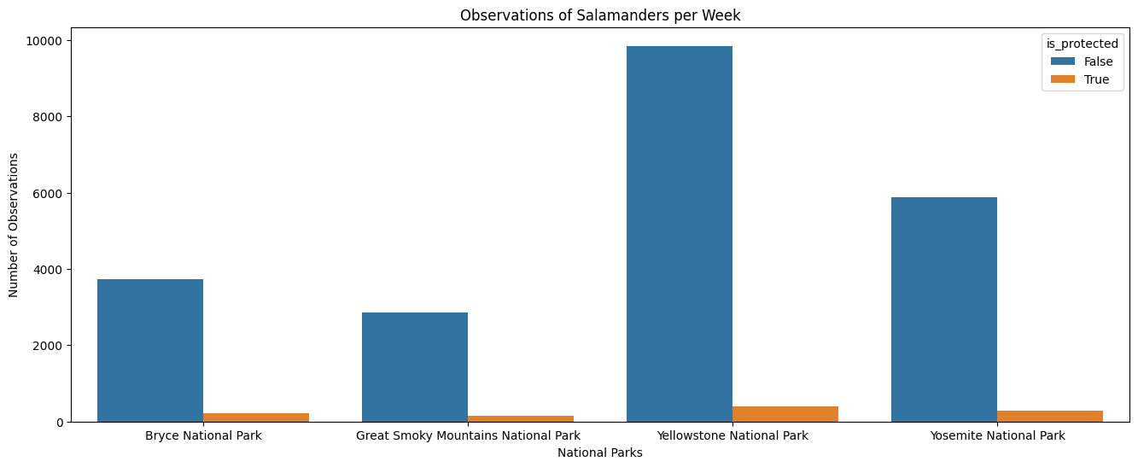

Slide 18
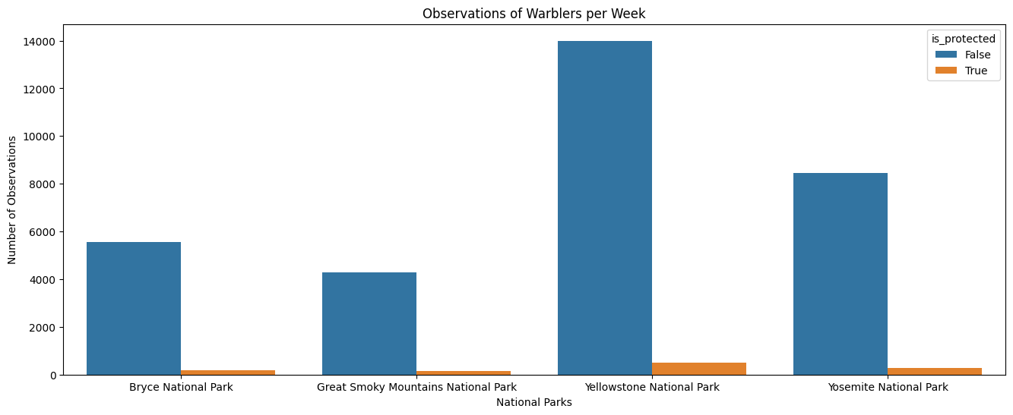

Slide 19
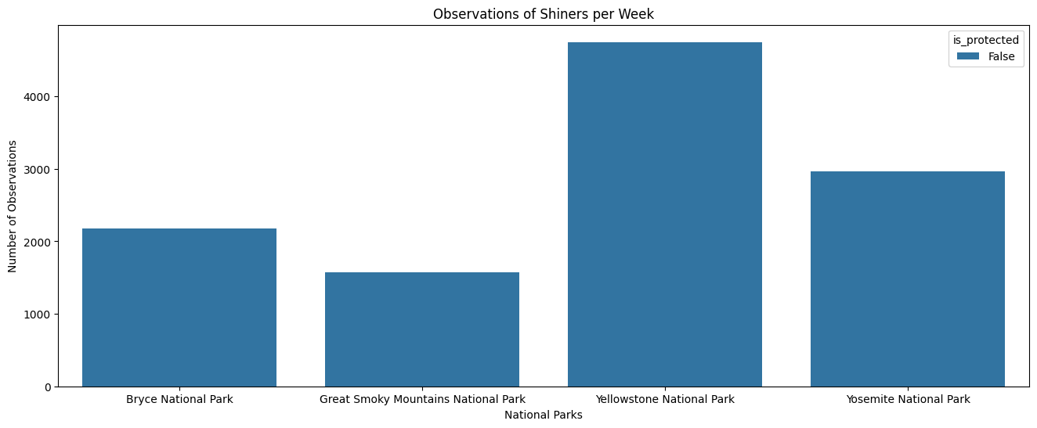

Slide 20
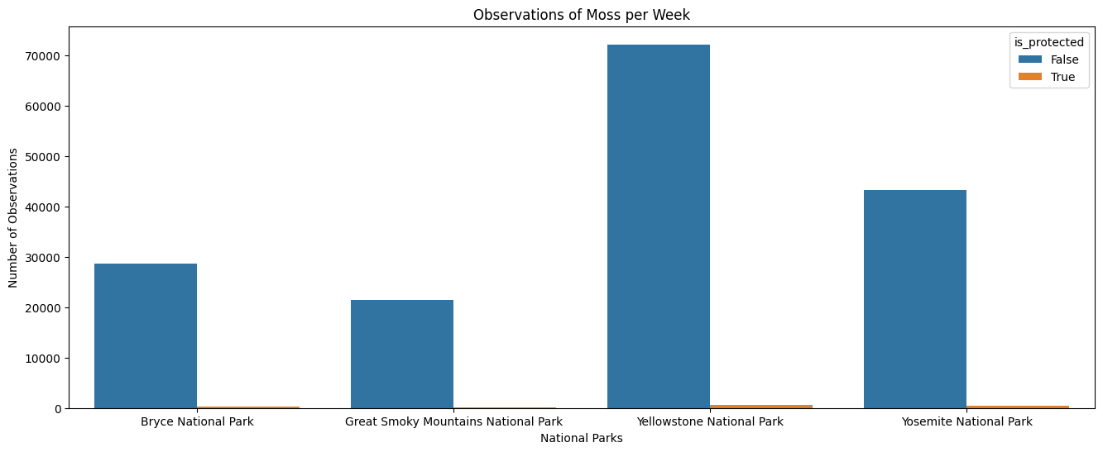

Slide 21
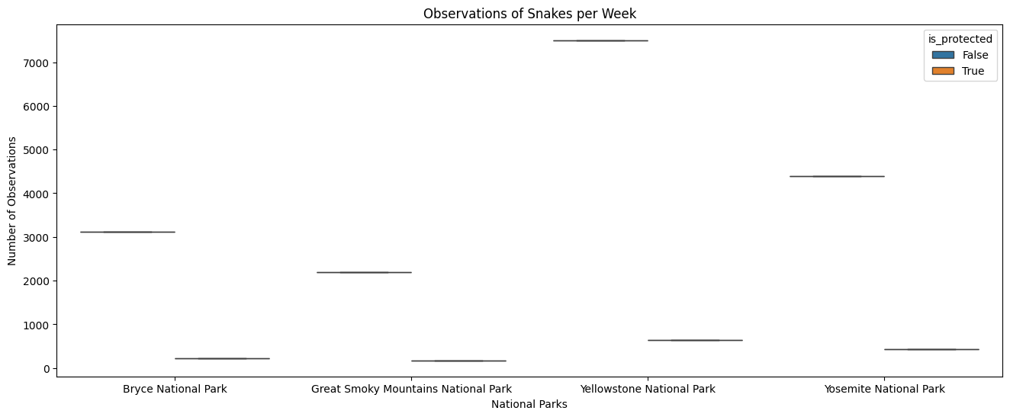

Slide 22


